Slide 1
Driving Food Marketers to Accelerate Progress on Childhood Obesity
Hank Cardello
April 5, 2011

Slide 2
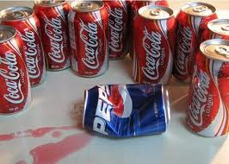
Corporate Model Not Designed to Fix Childhood Obesity
Growth
Consumer Demand
Competitive Advantage
Rewards

Slide 3
Obesity Solutions Initiative
Developing obesity solutions that drive food industry to act more quickly
Marketing/PR benefits
Financial Motivators
Policies that align interests of industry and public health

Slide 4
Building the Business Case - Part I
Identify the benefits of reducing calories and adopting "healthier" marketing practices on traditional corporate financial metrics
Compile “best practices” case studies delineating how certain companies have improved their business performance while reducing calories and/or improving marketing practices
Propose standards for CPG industry to evaluate performance on the basis of the alignment with healthier production and marketing practices
Completion: Fall, 2011

Slide 5
“Healthier” Danone Performing Better
(Earnings as % of Net Sales)
Source: Hudson Institute analysis

Slide 6
Building the Business Case – Part II
Assess the risks/costs if industry moves too slowly
Consumer brand switching
Competitive vulnerability
Regulatory exposure
Impact on reputation/negative publicity
Track progress in calorie reduction, and improvement in product profiles and marketing practices

Slide 7
Core Research Needs

Slide 8
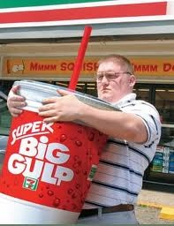
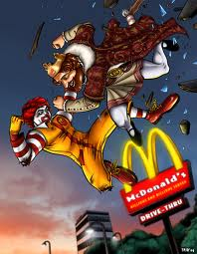
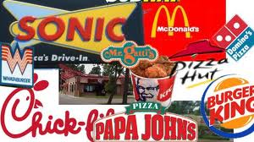
1. Huge Gap: Motivating Restaurant Chains
The Largest Food Channel
$580 billion (vs. Grocery @ $547 billion)
“Bigger” is more profitable
32 oz. 64 oz.
Price $ 1.59 $2.49
Cost .36 .68
Gross Profit $ 1.23 $ 1.81
Skittish that competitors won’t follow them to smaller sizes and healthier fare

Slide 9
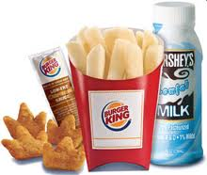
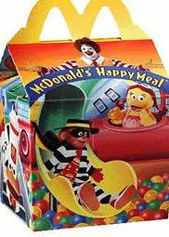
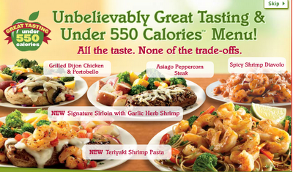
1. Huge Gap: Motivating Restaurant Chains
The Need
Comparable study as Part I for CPG companies
Demonstrate improvements to key financial/ marketing metrics by selling healthier and/or lower-calorie fare (“Show Me”)
Highlight peer “best practice” success stories
Devise Report Card to measure progress

Slide 10
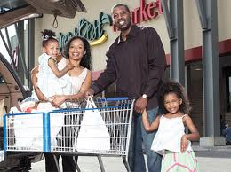
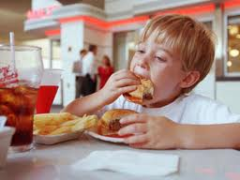
2. Need to Understand Consumers As Well As Marketers Do
Substantial gap in understanding different consumer behaviors relative to healthier eating & obesity

Slide 11
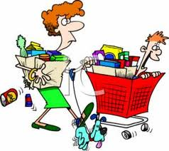
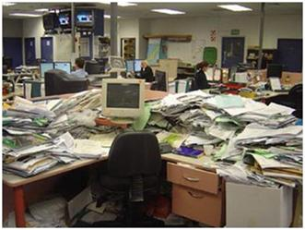
Consumers Behave Differently Toward Healthy Eating
2. Need to Understand Consumers As Well As Marketers Do
Walking Their Talk
(26%)
Looking for Help
(39%)
“Later”
(35%)
Source: Hudson analysis;

Slide 12
2. Need to Understand Consumers As Well As Marketers Do
The Need
Apply market segmentation principles to develop a comprehensive profile and understanding of the attitudes and behaviors of different consumer cohorts relative to:
Overweight/obese
Healthier eating
Receptivity to education/prompts
How personality differences affect eating behavior
Willingness to switch brands
How to communicate to them

Slide 13
2. Need to Understand Consumers As Well As Marketers Do
Benefits
Help determine optimal approaches to change/ improve eating behaviors
Assist in crafting more effective childhood obesity policies and messages
Aid in devising healthier merchandising programs for:
Supermarkets
Restaurant menus/prompts
CPG branded items

Slide 14
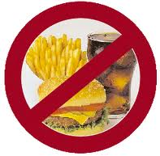
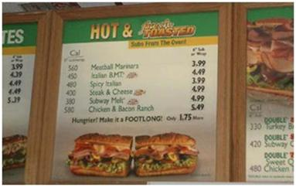
3. Policy Outcomes Evaluation
Key Issue: Industry resistant to change
Believe current policy actions are punitive to their business models
Skepticism re: effectiveness
(e.g.) Menu labeling
(e.g.) Fast food restaurant moratoriums

Slide 15
3. Policy Outcomes Evaluation
The Need
Provide guidance in developing strategies and policy proposals that can be effective in reducing calories sold
To determine the unintended consequences of proposed policy and regulatory scenarios in advance
To visually demonstrate the impact/benefits of proposed changes to industry(“Show me”)

Slide 16
3. Policy Outcomes Evaluation

Slide 17
3. Policy Outcomes Evaluation
Two-phase Approach
Restaurants
Moratoriums
Location/concentration near schools, playgrounds, etc.
Healthier/lower calorie menus near schools
Grocery
Higher % of displays with healthier foods
Change shelf positions/locations of healthier items
Healthier items at check-out

Slide 18
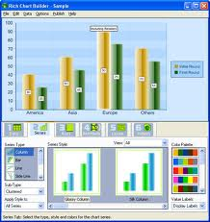
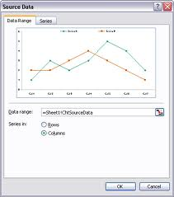
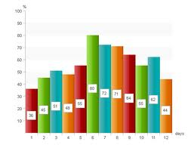
4. Improving Surveillance
Key Issue: Lacking good surveillance of the food stream
Must create new measures/metrics ourselves
High cost to secure data
Result: No standardized gauges to measure success

Slide 19
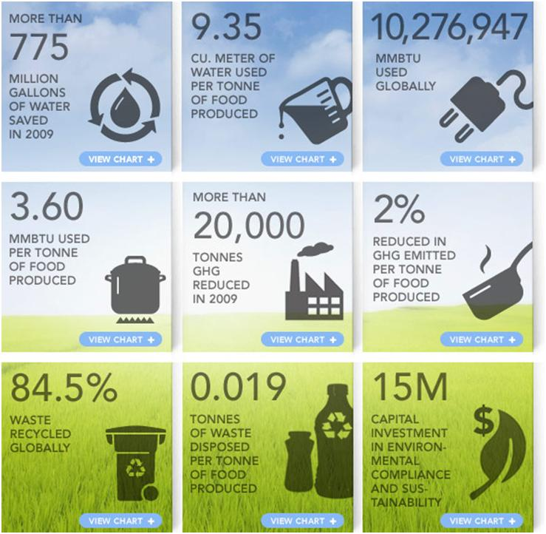
4. Improving Surveillance
The Need: Create the Wellness equivalent to core sustainability measures

Slide 20
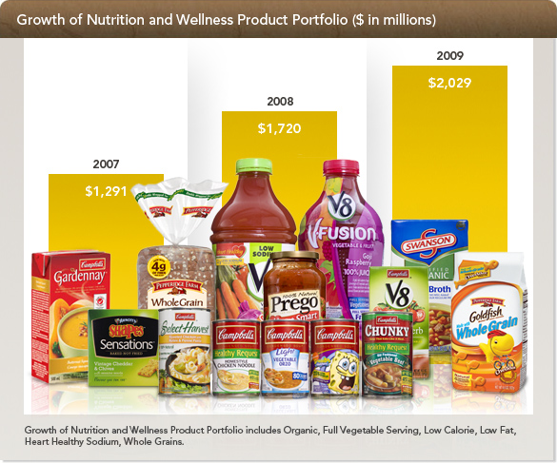
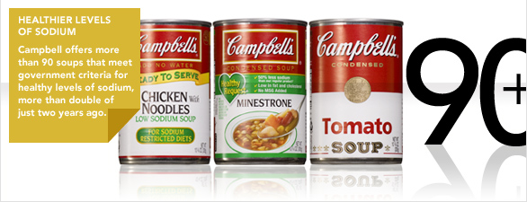
4. Improving Surveillance
Goal: Develop standard Wellness performance measures to be tracked in annual CSR reports
Decline in calories sold
% of portfolio in healthier products
% of marketing spent on children
% of children’s products that are healthier

Slide 21
Recap
Motivating Restaurant Chains to Change
Understanding Consumers As Well As Marketers Do
Policy Outcomes Evaluation
Improving Surveillance

